Slide 1

Work-let Name: CT006_RISC_V Vector Implementation of Channel Estimation and develop Custom vector Intrinsics of
Worklet Details
Worklet ID: CT006
College Name:Cambridge Institute of Technology Banglore
KPIs achieved till now
Matrix Multiplication executed for various matrix sizes (1×1, 5×5,16×16)
Peformance was analyzed by observing the number of clock cycles for matrix multipication of varying sizes.
Any Challenges/ Issues faced
Execution and display of large matrices in Ubuntu PULP showed errors due to their large size exceeding handling capacity.
Optimization inconsistency across different matrix sizes
Next Steps
Next step is to analyze performance for 64×64 and 256×256matrices to evaluate execution cycle variation with size.
Modify the C code to integrate the provided channel estimation algorithm and satisfy the required system specifications.
Key Achievements/ Outcome till now
Optimization of matrix multiplication core for various sizes
For matrix size 16×16, the executed output was correct and achieved with the least number of cycles, indicating optimized performance.
Date: 21-04-2025

Slide 2
Work-let Name: CT006_RISC_V Vector Implementation of Channel Estimation and develop Custom vector Intrinsics of
Worklet Details
Worklet ID: CT006
College Name: Cambridge Institute of Technology Banglore
Requirement: C compiler (e.g., GCC)), Linux/Windows OS
Status: C environment setup complete; dataset under review; initial test code compiled and working
PRISM:Registered
Resource Requirement Identified with Status
Github Repository Link and PRISM Portal Registration
Status
Any Anticipated Break (Due to exams etc)
Internals :27-03-2025 To 29-03-2025
Is the data self-collected, If yes then is the consent form submitted.
If open source then the dataset link
Data Collection Information
Date: 21-04-2025

Slide 3
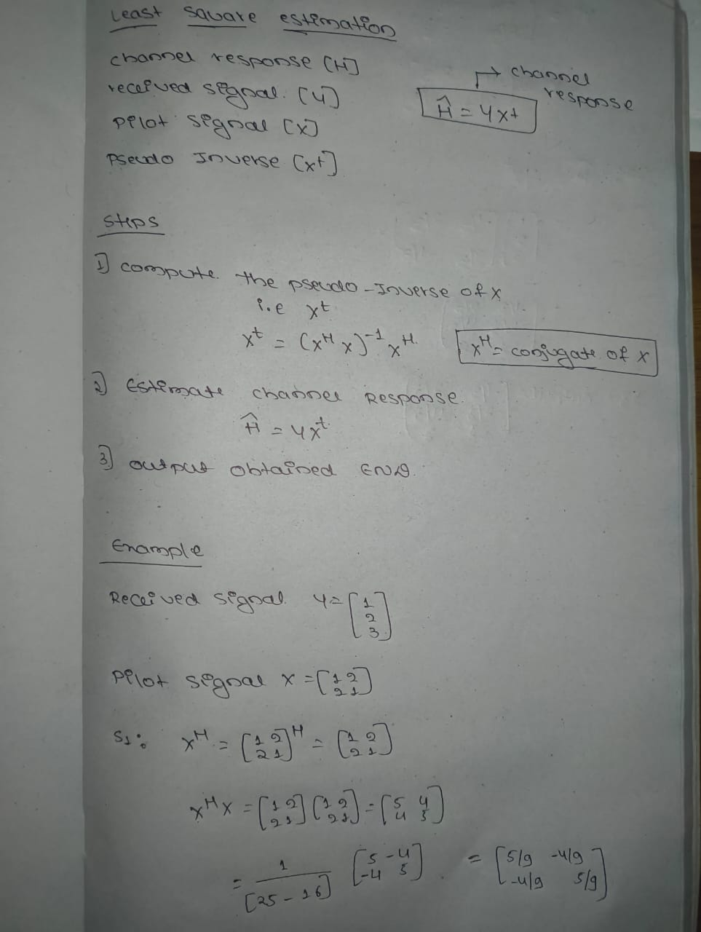
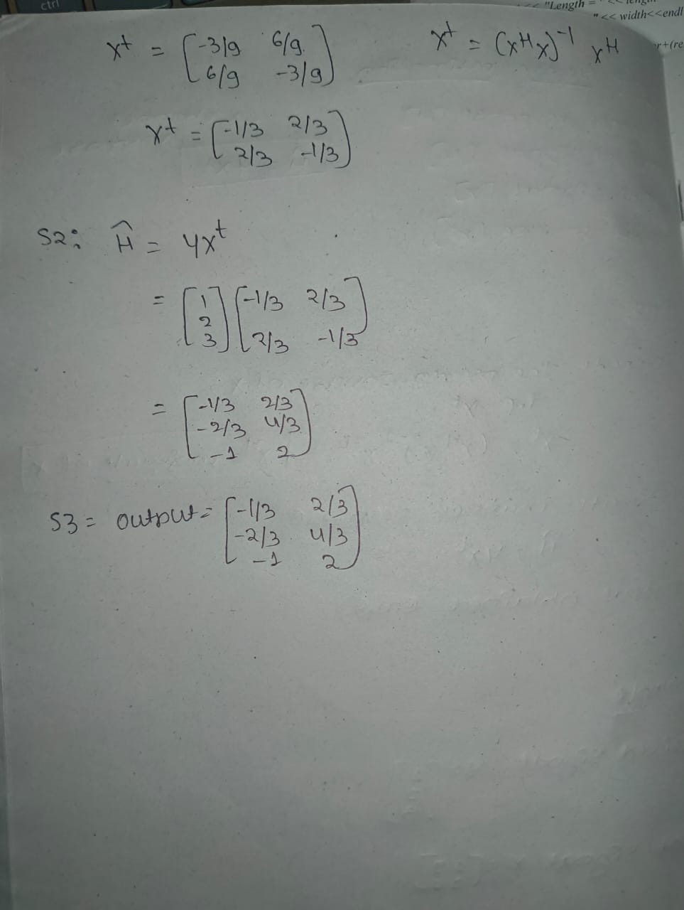
Work-let Name: CT006_RISC_V Vector Implementation of Channel Estimation and develop Custom vector Intrinsics
Worklet Details
Worklet ID: CT006
College Name:Cambridge Institute of Technology Banglore
Least Square Estimation Algorithm
Date: 21-04-2025

Slide 4
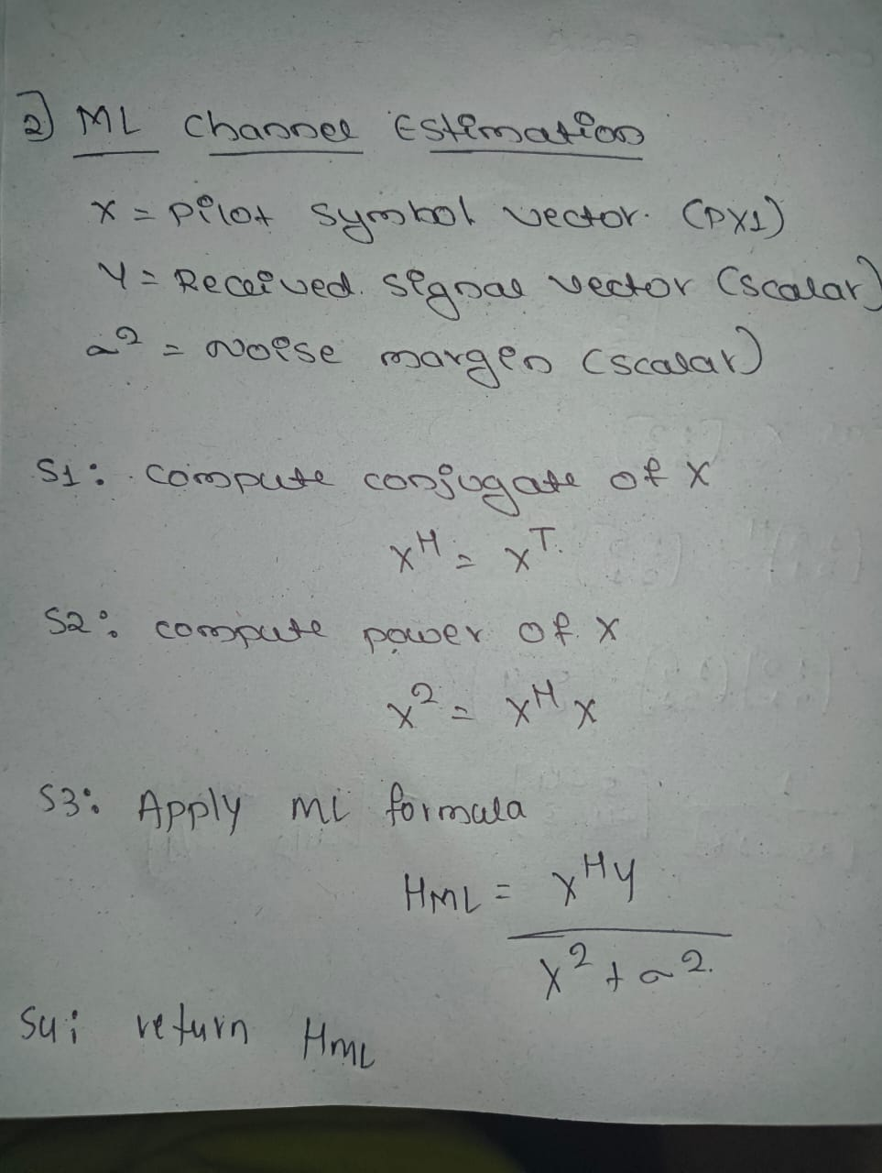
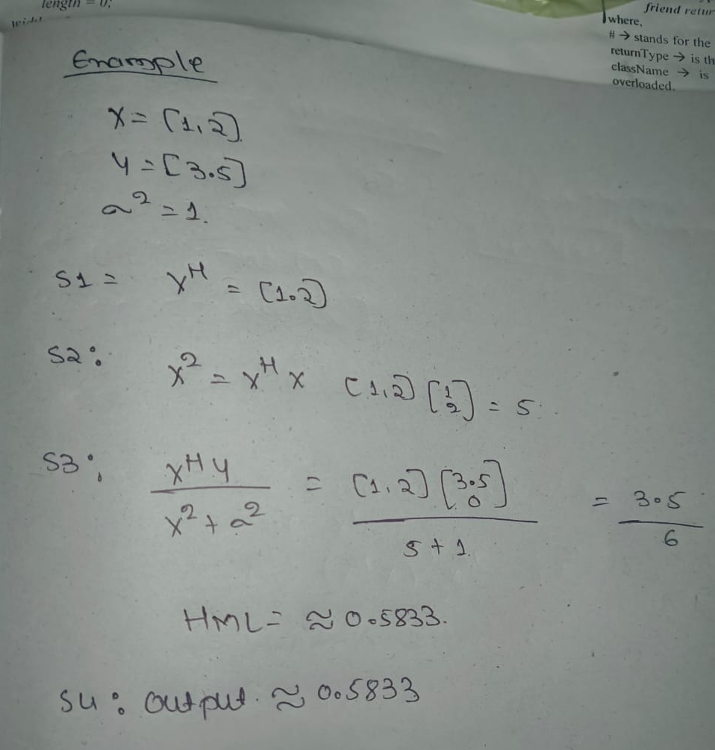
Work-let Name: CT006_RISC_V Vector Implementation of Channel Estimation and develop Custom vector Intrinsics of
Worklet Details
Worklet ID: CT006
College Name:Cambridge Institute of Technology Banglore
ML Channel Estimation Algorithm
Date: 21-04-2025

Slide 5
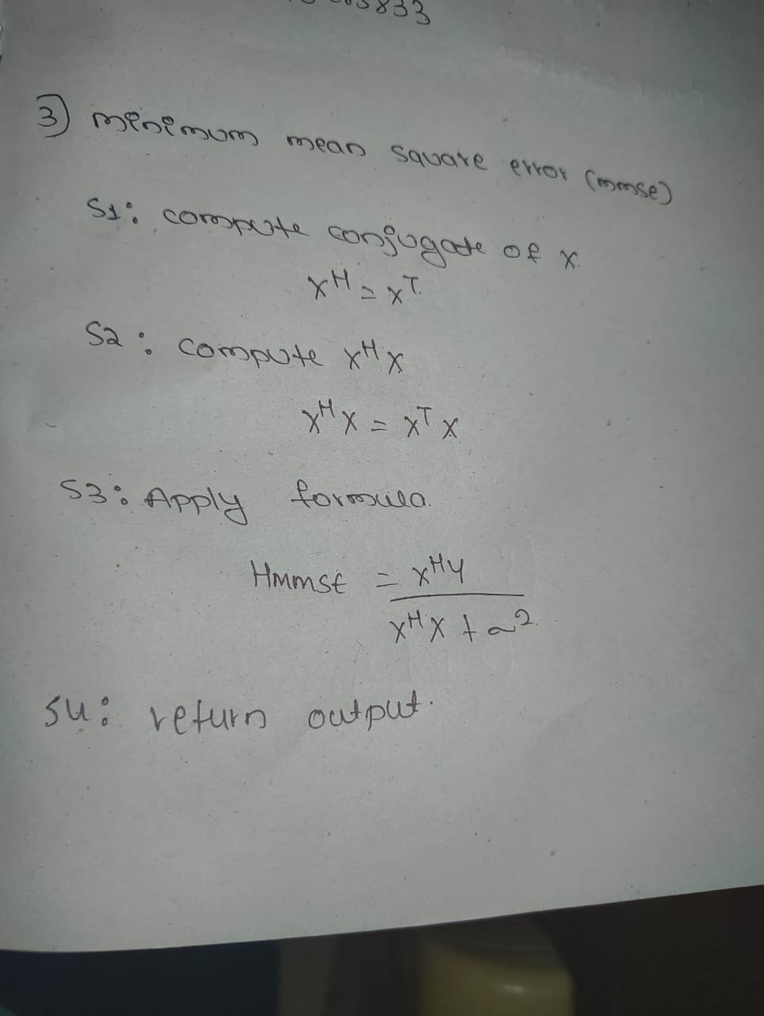
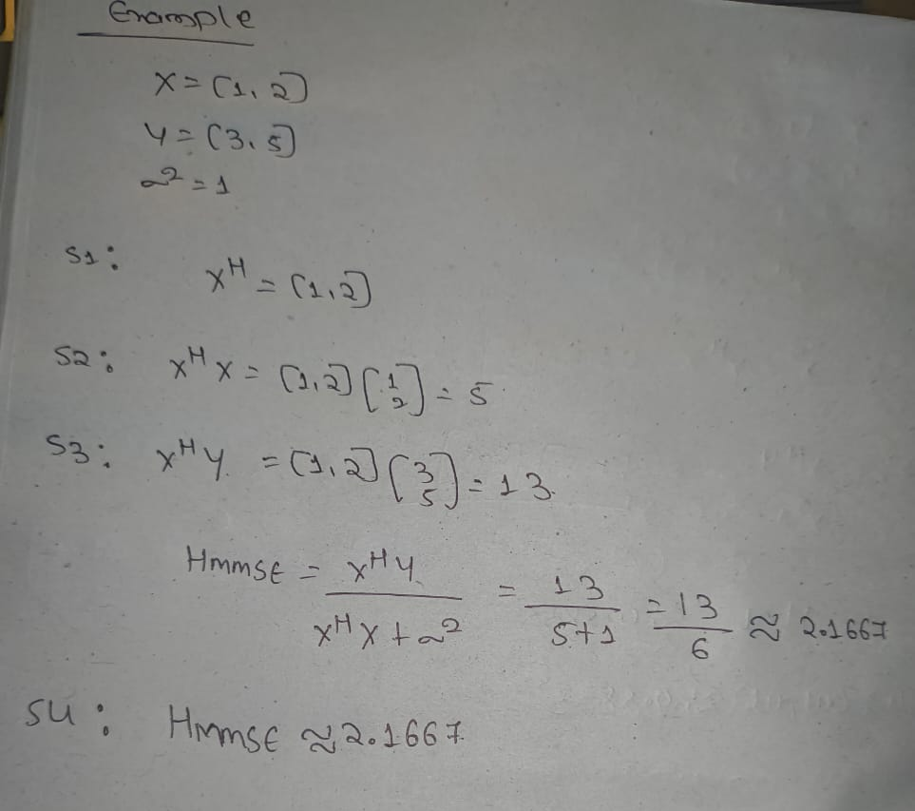
Work-let Name: CT006_RISC_V Vector Implementation of Channel Estimation and develop Custom vector Intrinsics of
Worklet Details
Worklet ID: CT006
College Name:Cambridge Institute of Technology Banglore
Minimum Square Error Algorith
Date: 21-04-2025

Slide 6
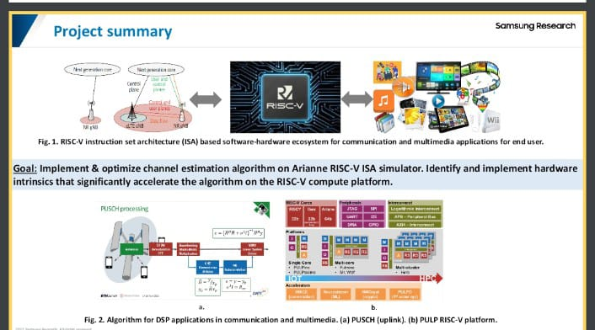
Work-let Name: CT006_RISC_V Vector Implementation of Channel Estimation and develop Custom vector Intrinsics of
Worklet Details
Worklet ID: CT006_RISC_V
College Name:Cambridge Institute of Technology Banglore
Block Diagram
Date: 21-04-2025

Slide 7
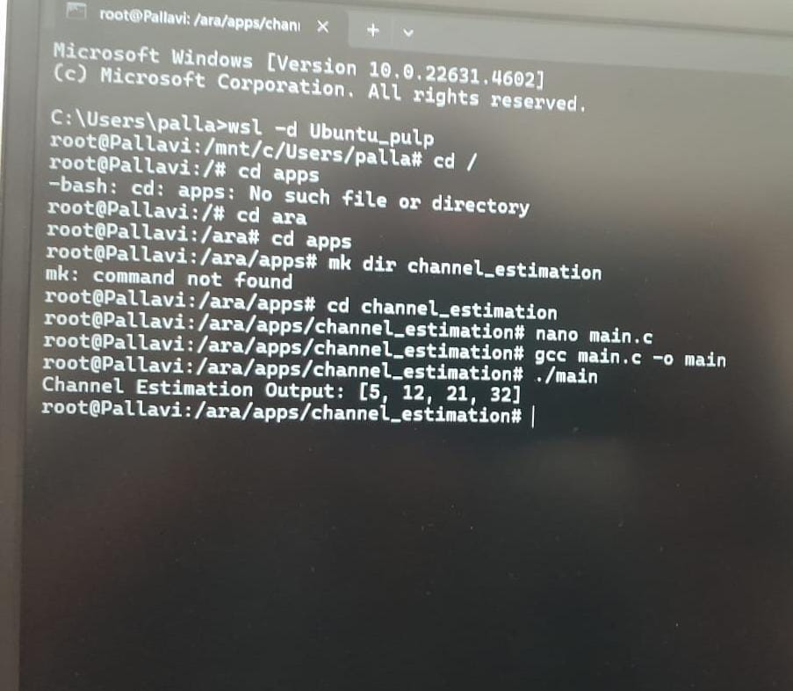
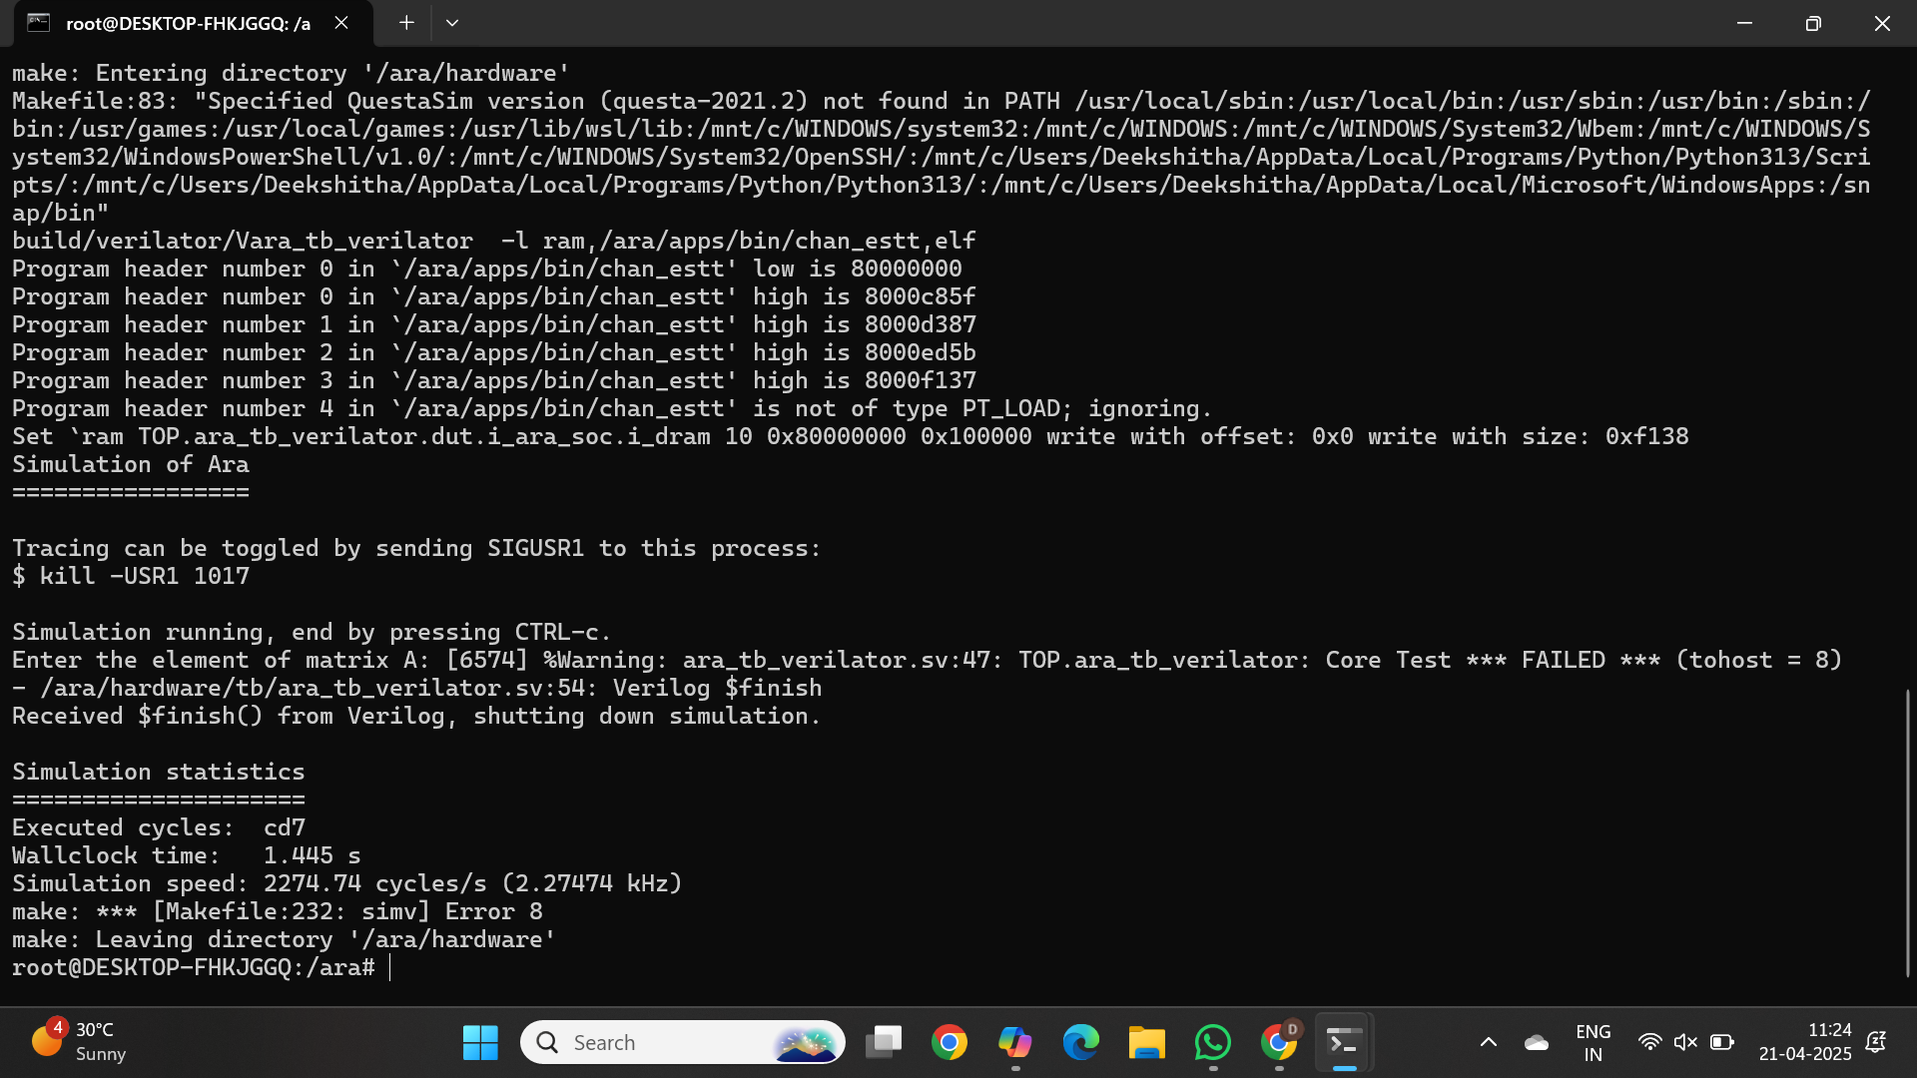
Work-let Name: CT006_RISC_V Vector Implementation of Channel Estimation and develop Custom vector Intrinsics of
Worklet Details
Worklet ID: CT006
College Name:Cambridge Institute of Technology Banglore
output for 1*1 matrix multiplication
Date: 21-04-2025

Slide 8
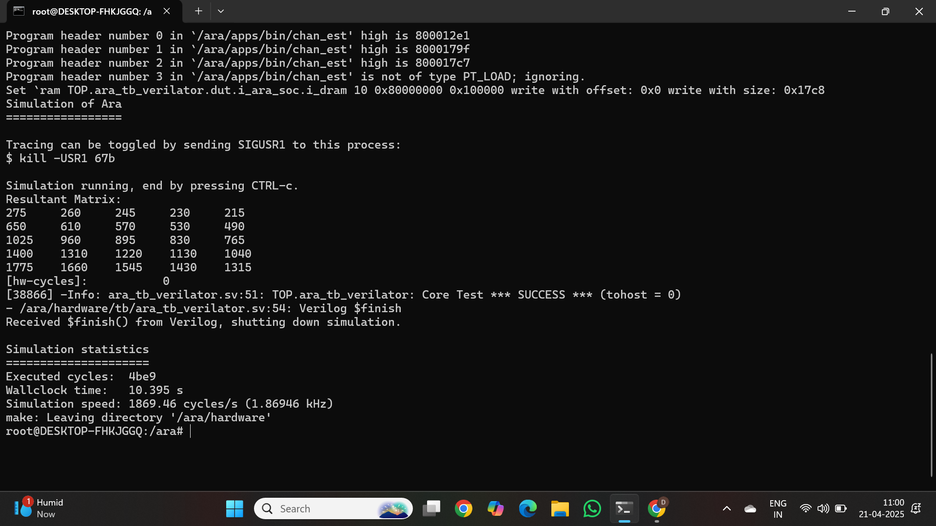
Work-let Name: CT006_RISC_V Vector Implementation of Channel Estimation and develop Custom vector Intrinsics of
Worklet Details
Worklet ID: CT006
College Name:Cambridge Institute of Technology Banglore
output for 5*5 matrix multiplication
Date: 21-04-2025

Slide 9
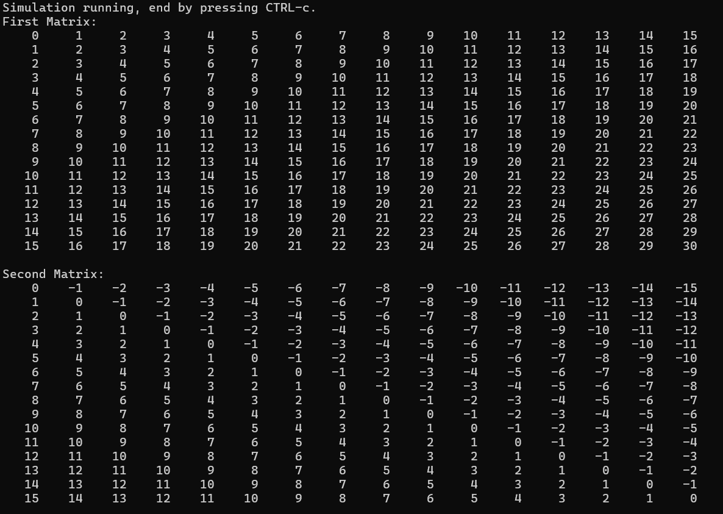
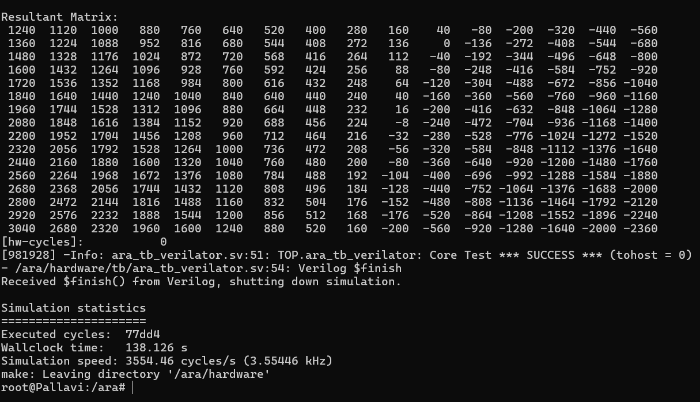
Work-let Name: CT006_RISC_V Vector Implementation of Channel Estimation and develop Custom vector Intrinsics of
Worklet Details
Worklet ID: CT006_RISC_V
College Name:Cambridge Institute of Technology Banglore
output for 16*16
Date: 21-04-2025

Slide 10
Program for 16*16 matrix multiplication
#include <stdio.h>
#include <riscv_vector.h>
#define SIZE 16
void multiplyMatrices(int firstMatrix[SIZE][SIZE],
int secondMatrix[SIZE][SIZE],
int result[SIZE][SIZE])
{
for (int i = 0; i < SIZE; i++)
{
for (int j = 0; j < SIZE; j++)
{
result[i][j] = 0;
for (int k = 0; k < SIZE; k++)
{
result[i][j] += firstMatrix[i][k] * secondMatrix[k][j];
}
}
}
}void printMatrix(int matrix[SIZE][SIZE])
{
for (int i = 0; i < SIZE; i++)

Slide 11
{
for (int j = 0; j < SIZE; j++)
{
printf("%5d ", matrix[i][j]);
}
printf("\n");
}
}
int main()
{
int firstMatrix[SIZE][SIZE], secondMatrix[SIZE][SIZE], result[SIZE][SIZE];
// Initializing matrices with sample values
for (int i = 0; i < SIZE; i++)
{
for (int j = 0; j < SIZE; j++)
{ firstMatrix[i][j] = i + j; secondMatrix[i][j] = i - j;
}
}
printf("First Matrix:\n");
printMatrix(firstMatrix);
printf("\nSecond Matrix:\n");
printMatrix(secondMatrix);
multiplyMatrices(firstMatrix, secondMatrix, result);
printf("\nResultant Matrix:\n");
printMatrix(result);
return 0;}

Slide 12
Program for 16*16 matrix multiplication[alternative]
Worklet ID: CT006_RISC_V
Co
#include <printf.h>
#include <riscv_vector.h>
#include <stdint.h>
#include <math.h>
void fmatmul_16x16(double *c, const double *a, const double *b,
unsigned long int m, unsigned long int n,
unsigned long int p);
void fmatmul_vec_16x16_slice_init();
void fmatmul_vec_16x16(double *c, const double *a, const double *b,
unsigned long int n, unsigned long int p);
#define MIN(a, b) ((a) < (b) ? (a) : (b))
/*void generate_random_matrix(double *matrix, int rows, int cols, double max_val) {
for (int i = 0; i < rows; ++i) {
for (int j = 0; j < cols; ++j) {
matrix[i * cols + j] = ((double)rand() / RAND_MAX) * max_val;
}
Date: 21-04-2025

Slide 13
}
}*/
void fmatmul_16x16(double *c, const double *a, const double *b,
unsigned long int M, unsigned long int N,
unsigned long int P) {
const unsigned long int block_size = 16;
unsigned long int block_size_p;
asm volatile("vsetvli %0, %1, e64, m1, ta, ma" : "=r"(block_size_p) : "r"(P));
for (unsigned long int p = 0; p < P; p += block_size_p) {
const unsigned long int p_ = MIN(P - p, block_size_p);
const double *b_ = b + p;
double *c_ = c + p;
asm volatile("vsetvli zero, %0, e64, m1, ta, ma" ::"r"(p_));

Slide 14
for (unsigned long int m = 0; m < M; m += block_size) {
const double *a_ = a + m * N;
double *c__ = c_ + m * P;
fmatmul_vec_16x16_slice_init();
fmatmul_vec_16x16(c__, a_, b_, N, P);
}
}
}
void fmatmul_vec_16x16_slice_init() {
asm volatile("vmv.v.i v0, 0");
asm volatile("vmv.v.i v1, 0");
asm volatile("vmv.v.i v2, 0");
asm volatile("vmv.v.i v3, 0");
asm volatile("vmv.v.i v4, 0");
asm volatile("vmv.v.i v5, 0");
asm volatile("vmv.v.i v6, 0");
asm volatile("vmv.v.i v7, 0");
asm volatile("vmv.v.i v8, 0");
asm volatile("vmv.v.i v9, 0");

Slide 15
asm volatile("vmv.v.i v10, 0");
asm volatile("vmv.v.i v11, 0");
asm volatile("vmv.v.i v12, 0");
asm volatile("vmv.v.i v13, 0");
asm volatile("vmv.v.i v14, 0");
asm volatile("vmv.v.i v15, 0");
}
void fmatmul_vec_16x16(double *c, const double *a, const double *b,
const unsigned long int N, const unsigned long int P) {
double t0, t1, t2, t3, t4, t5, t6, t7, t8, t9, t10, t11, t12, t13, t14, t15;
const double *a_ = a;
t0 = *a, a += N;
t1 = *a, a += N;
t2 = *a, a += N;
t3 = *a, a += N;
t4 = *a, a += N;
t5 = *a, a += N;
t6 = *a, a += N;

Slide 16
t7 = *a, a += N;
t8 = *a, a += N;
t9 = *a, a += N;
t10 = *a, a += N;
t11 = *a, a += N;
t12 = *a, a += N;
t13 = *a, a += N;
t14 = *a, a += N;
t15 = *a;
asm volatile("vle64.v v16, (%0);" ::"r"(b));
b += P;
unsigned long int n = 0;
while (n != N) {
#ifdef VCD_DUMP
if (n == 8)
event_trigger = +1;
if (n == 12)
event_trigger = -1;
#endif

Slide 17
t7 = *a, a += N;
t8 = *a, a += N;
t9 = *a, a += N;
t10 = *a, a += N;
t11 = *a, a += N;
t12 = *a, a += N;
t13 = *a, a += N;
t14 = *a, a += N;
t15 = *a;
asm volatile("vle64.v v16, (%0);" ::"r"(b));
b += P;
unsigned long int n = 0;
while (n != N) {
#ifdef VCD_DUMP
if (n == 8)
event_trigger = +1;
if (n == 12)
event_trigger = -1;
#endif

Slide 18
a = a_ + ++n;
asm volatile("vfmacc.vf v0, %0, v16" ::"f"(t0));
t0 = *a, a += N;
asm volatile("vle64.v v17, (%0);" ::"r"(b));
b += P;
asm volatile("vfmacc.vf v1, %0, v16" ::"f"(t1));
t1 = *a, a += N;
asm volatile("vfmacc.vf v2, %0, v16" ::"f"(t2));
t2 = *a, a += N;
asm volatile("vfmacc.vf v3, %0, v16" ::"f"(t3));
t3 = *a, a += N;
asm volatile("vfmacc.vf v4, %0, v16" ::"f"(t4));
t4 = *a, a += N;
asm volatile("vfmacc.vf v5, %0, v16" ::"f"(t5));
t5 = *a, a += N;
asm volatile("vfmacc.vf v6, %0, v16" ::"f"(t6));
t6 = *a, a += N;
asm volatile("vfmacc.vf v7, %0, v16" ::"f"(t7));
t7 = *a, a += N;

Slide 19
asm volatile("vfmacc.vf v8, %0, v16" ::"f"(t8));
t8 = *a, a += N;
asm volatile("vfmacc.vf v9, %0, v16" ::"f"(t9));
t9 = *a, a += N;
asm volatile("vfmacc.vf v10, %0, v16" ::"f"(t10));
t10 = *a, a += N;
asm volatile("vfmacc.vf v11, %0, v16" ::"f"(t11));
t11 = *a, a += N;
asm volatile("vfmacc.vf v12, %0, v16" ::"f"(t12));
t12 = *a, a += N;
asm volatile("vfmacc.vf v13, %0, v16" ::"f"(t13));
t13 = *a, a += N;
asm volatile("vfmacc.vf v14, %0, v16" ::"f"(t14));
t14 = *a, a += N;
asm volatile("vfmacc.vf v15, %0, v16" ::"f"(t15));
t15 = *a;
a = a_ + ++n;
if (n == N)
break;
asm volatile("vfmacc.vf v0, %0, v17" ::"f"(t0));
t0 = *a, a += N;

Slide 20
// Load one row of B
asm volatile("vle64.v v16, (%0);" ::"r"(b));
b += P;
asm volatile("vfmacc.vf v1, %0, v17" ::"f"(t1));
t1 = *a, a += N;
asm volatile("vfmacc.vf v2, %0, v17" ::"f"(t2));
t2 = *a, a += N;
asm volatile("vfmacc.vf v3, %0, v17" ::"f"(t3));
t3 = *a, a += N;
asm volatile("vfmacc.vf v4, %0, v17" ::"f"(t4));
t4 = *a, a += N;
asm volatile("vfmacc.vf v5, %0, v17" ::"f"(t5));
t5 = *a, a += N;
asm volatile("vfmacc.vf v6, %0, v17" ::"f"(t6));
t6 = *a, a += N;
asm volatile("vfmacc.vf v7, %0, v17" ::"f"(t7));
t7 = *a, a += N;
asm volatile("vfmacc.vf v8, %0, v17" ::"f"(t8));
t8 = *a, a += N;
asm volatile("vfmacc.vf v9, %0, v17" ::"f"(t9));
t9 = *a, a += N;
asm volatile("vfmacc.vf v10, %0, v17" ::"f"(t10));
t10 = *a, a += N;

Slide 21
asm volatile("vfmacc.vf v11, %0, v17" ::"f"(t11));
t11 = *a, a += N;
asm volatile("vfmacc.vf v12, %0, v17" ::"f"(t12));
t12 = *a, a += N;
asm volatile("vfmacc.vf v13, %0, v17" ::"f"(t13));
t13 = *a, a += N;
asm volatile("vfmacc.vf v14, %0, v17" ::"f"(t14));
t14 = *a, a += N;
asm volatile("vfmacc.vf v15, %0, v17" ::"f"(t15));
t15 = *a;
}
// Last iteration: store results
asm volatile("vfmacc.vf v0, %0, v17" ::"f"(t0));
asm volatile("vse64.v v0, (%0);" ::"r"(c));
c += P;
asm volatile("vfmacc.vf v1, %0, v17" ::"f"(t1));
asm volatile("vse64.v v1, (%0);" ::"r"(c));
c += P;
asm volatile("vfmacc.vf v2, %0, v17" ::"f"(t2));
asm volatile("vse64.v v2, (%0);" ::"r"(c));
c += P;

Slide 22
asm volatile("vfmacc.vf v3, %0, v17" ::"f"(t3));
asm volatile("vse64.v v3, (%0);" ::"r"(c));
c += P;
asm volatile("vfmacc.vf v4, %0, v17" ::"f"(t4));
asm volatile("vse64.v v4, (%0);" ::"r"(c));
c += P;
asm volatile("vfmacc.vf v5, %0, v17" ::"f"(t5));
asm volatile("vse64.v v5, (%0);" ::"r"(c));
c += P;
asm volatile("vfmacc.vf v6, %0, v17" ::"f"(t6));
asm volatile("vse64.v v6, (%0);" ::"r"(c));
c += P;
asm volatile("vfmacc.vf v7, %0, v17" ::"f"(t7));
asm volatile("vse64.v v7, (%0);" ::"r"(c));
c += P;
asm volatile("vfmacc.vf v8, %0, v17" ::"f"(t8));
asm volatile("vse64.v v8, (%0);" ::"r"(c));
c += P;
asm volatile("vfmacc.vf v9, %0, v17" ::"f"(t9));
asm volatile("vse64.v v9, (%0);" ::"r"(c));
c += P;
asm volatile("vfmacc.vf v10, %0, v17" ::"f"(t10));
asm volatile("vse64.v v10, (%0);" ::"r"(c));

Slide 23
c += P;
asm volatile("vfmacc.vf v11, %0, v17" ::"f"(t11));
asm volatile("vse64.v v11, (%0);" ::"r"(c));
c += P;
asm volatile("vfmacc.vf v12, %0, v17" ::"f"(t12));
asm volatile("vse64.v v12, (%0);" ::"r"(c));
c += P;
asm volatile("vfmacc.vf v13, %0, v17" ::"f"(t13));
asm volatile("vse64.v v13, (%0);" ::"r"(c));
c += P;
asm volatile("vfmacc.vf v14, %0, v17" ::"f"(t14));
asm volatile("vse64.v v14, (%0);" ::"r"(c));
c += P;
asm volatile("vfmacc.vf v15, %0, v17" ::"f"(t15));
asm volatile("vse64.v v15, (%0);" ::"r"(c));
}
void printnumb(double *numb, int rows, int cols) {
for (int i = 0; i < rows; i++) {
for (int j = 0; j < cols; j++) {
printf("%6.1f ", numb[i * cols + j]);
}
printf("\n");

Slide 24
}
}
int main(){
double x[256] = {
48, 27, 31, 17, 46, 13, 28, 4, 49, 25, 41, 26, 32, 27, 13, 33,
18, 43, 42, 2, 47, 18, 42, 28, 17, 1, 5, 16, 28, 2, 25, 23,
27, 42, 27, 16, 40, 30, 14, 7, 7, 11, 36, 27, 43, 13, 31, 14,
22, 38, 22, 16, 30, 22, 38, 39, 30, 20, 45, 5, 12, 48, 40, 19,
4, 15, 31, 10, 48, 1, 14, 15, 30, 1, 2, 18, 16, 9, 31, 46,
18, 47, 47, 13, 1, 13, 10, 37, 41, 21, 12, 3, 26, 27, 29, 39,
34, 13, 40, 5, 20, 49, 23, 15, 23, 3, 45, 15, 11, 4, 9, 43,
2, 30, 5, 5, 18, 18, 1, 40, 17, 24, 42, 17, 25, 42, 16, 49,
41, 4, 7, 6, 10, 48, 6, 32, 16, 21, 6, 45, 39, 35, 3, 42,
48, 12, 13, 46, 21, 31, 2, 21, 43, 28, 36, 45, 17, 1, 24, 32,
38, 33, 43, 44, 46, 15, 22, 21, 3, 47, 3, 6, 12, 5, 15, 6,
37, 6, 27, 8, 48, 16, 32, 24, 37, 21, 28, 10, 32, 27, 17, 46,
36, 40, 39, 11, 34, 23, 18, 3, 1, 28, 38, 30, 29, 6, 28, 14,
9, 36, 48, 19, 7, 28, 15, 38, 1, 45, 38, 10, 28, 48, 33, 2,
43, 28, 26, 30, 5, 49, 17, 31, 30, 19, 31, 35, 4, 8, 16, 46,
4, 3, 3, 6, 20, 10, 8, 10, 16, 20, 8, 32, 18, 30, 42, 6 };

Slide 25
double y[256] = {
48, 27, 31, 17, 46, 13, 28, 4, 49, 25, 41, 26, 32, 27, 13, 33,
18, 43, 42, 2, 47, 18, 42, 28, 17, 1, 5, 16, 28, 2, 25, 23,
27, 42, 27, 16, 40, 30, 14, 7, 7, 11, 36, 27, 43, 13, 31, 14,
22, 38, 22, 16, 30, 22, 38, 39, 30, 20, 45, 5, 12, 48, 40, 19,
4, 15, 31, 10, 48, 1, 14, 15, 30, 1, 2, 18, 16, 9, 31, 46,
18, 47, 47, 13, 1, 13, 10, 37, 41, 21, 12, 3, 26, 27, 29, 39,
34, 13, 40, 5, 20, 49, 23, 15, 23, 3, 45, 15, 11, 4, 9, 43,
2, 30, 5, 5, 18, 18, 1, 40, 17, 24, 42, 17, 25, 42, 16, 49,
41, 4, 7, 6, 10, 48, 6, 32, 16, 21, 6, 45, 39, 35, 3, 42,
48, 12, 13, 46, 21, 31, 2, 21, 43, 28, 36, 45, 17, 1, 24, 32,
38, 33, 43, 44, 46, 15, 22, 21, 3, 47, 3, 6, 12, 5, 15, 6,
37, 6, 27, 8, 48, 16, 32, 24, 37, 21, 28, 10, 32, 27, 17, 46,
36, 40, 39, 11, 34, 23, 18, 3, 1, 28, 38, 30, 29, 6, 28, 14,
9, 36, 48, 19, 7, 28, 15, 38, 1, 45, 38, 10, 28, 48, 33, 2,
43, 28, 26, 30, 5, 49, 17, 31, 30, 19, 31, 35, 4, 8, 16, 46,
4, 3, 3, 6, 20, 10, 8, 10, 16, 20, 8, 32, 18, 30, 42, 6 };
double zv[256] = {0};
fmatmul_16x16(zv, x, y, 16, 16, 16);
printf("\n");
printf("success!\n");
printnumb(zv, 16, 16);
return 0;
}

Slide 26
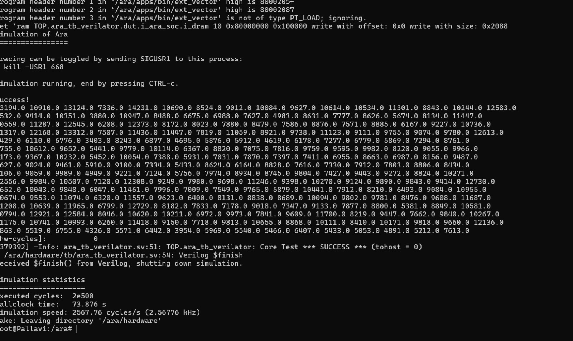
output

Slide 27
output for different cycles
Size | Executed Cycles | Wallclock Time | Simulation Speed(cycles/sec)
1*1 | cd7 | 1.445s | 2274.74
5*5 | 4be9 | 10.395s | 1869.46
16*16 | 77dd4 | 138.126s | 3554.46

Slide 28
Work-let Name: CT006_RISC_V Vector Implementation of Channel Estimation and develop Custom vector Intrinsics of
Worklet Details
Worklet ID: CT006
College Name:Cambridge Institute of Technology Banglore
Status and future plan
The worklet progress is satisfactory based on the targets allocated
Latest Literature Review
Litereature Review on Channe Estinmation Based Matrix Muliplication
Expert Insights
Studied the algorithms.
Any other comment
Need to work on ARIANNA and optimization based on 1024.
Professor Comments (To be filled in and presented by professor (Either)
COMPUTATION RESOURCE Details:
[Google Collab/ Kaggle / GPU from College lab with compute hours etc]
Date: 21-04-2025

